Slide 1
Week 8 Update
AA 290 / AA 279D
11/12/2019

Slide 2
Contents
Troubleshooting ROE Dynamics
Switched to new STM
Added Guidance Modes
Implemented ROE space inside inertial simulation
Added Drag
Added UKF
Added maneuver planning – one question on this

Slide 3
ROE Propagation
After changing to the STM accounting for J2 without small angle approximation results were as expected:

Slide 4
Guidance Modes – Bounding Motion with ROE
Currently just setting up new architecture:
Calculate the bounding burn using ROE now → just looked at da, not accounting for changes in others

Slide 6
Guidance Modes – Circularize Motion
Also working on circularizing the orbit:

Slide 7
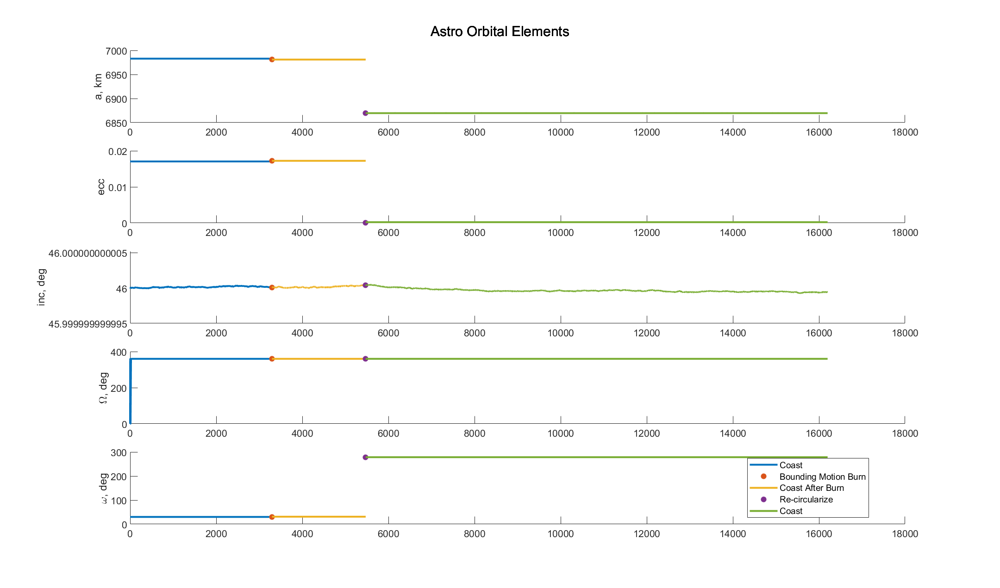

Slide 8
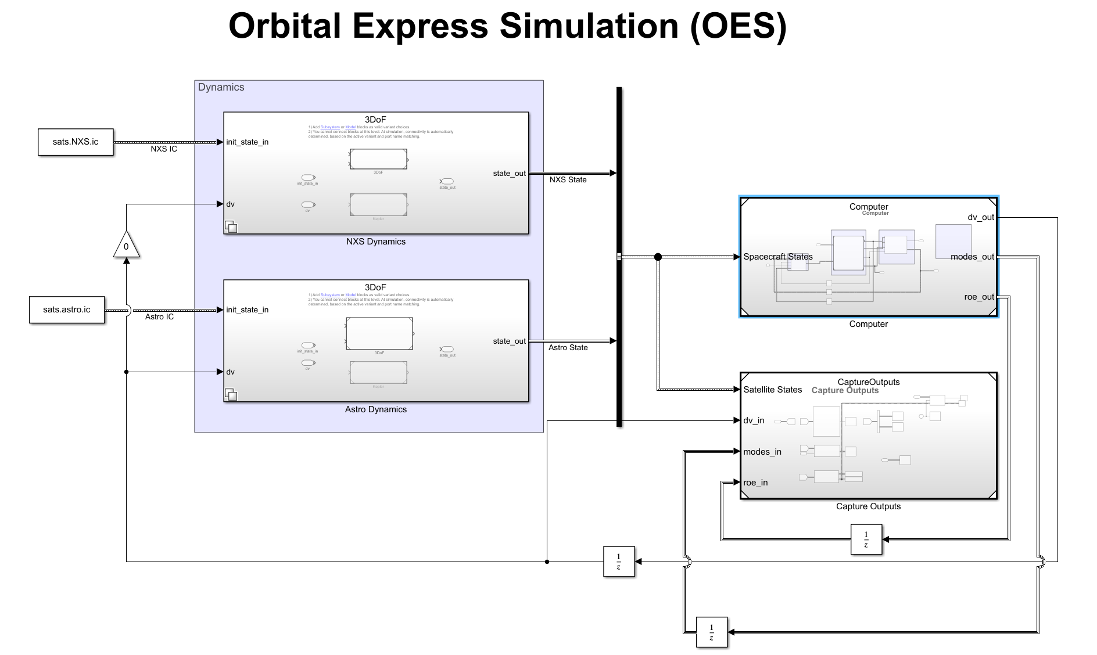
Sim Changes
Ground Truth: Inertial propagation with perturbations
Computer: Calculate ROEs/Hill Frame for moding and burn calculations

Slide 9
Plan for next week
Drag
Continue with mission planning:
More guidance in ROE state
Figure out what the desired ROEs for different phases of mission to only use those for maneuver planning
Navigation → EKF
Fix plotting for ROEs with maneuvers, currently not implemented due to issues with propagating with burns occurring
Future Work:
Controller

Slide 10
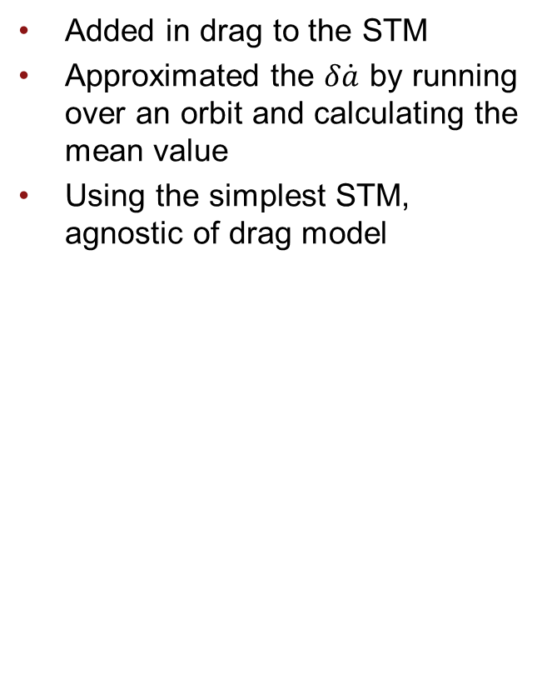
Drag Implementation
Added in drag to the STM
Approximated the $δ\dot{a}$ by running over an orbit and calculating the mean value
Using the simplest STM, agnostic of drag model

Slide 11
J2 + Drag

Slide 12
UKF
Currently have a “sensor” that returns noisy relative position and velocity
Use UKF to estimate the ROEs
Propagate them with the full STM
Measurement model is currently changing ROEs to relative position and velocity

Slide 13
UKF Results
No Burns
With Burns

Slide 14
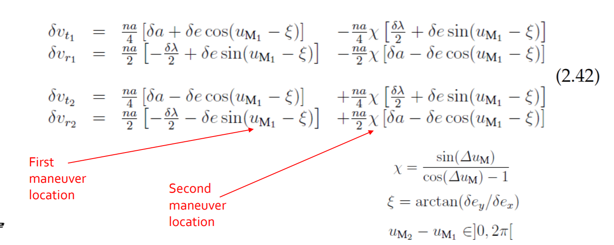
Maneuver Planning
Implemented the equations below:
What exactly is delta e
Is Xi at the starting position?

Slide 15
ROE Maneuvers
Doing same as before, setting da to 0
Bounds the motion as expected

Slide 16
Future Work
Finish mission planning
Implement rendezvous
Maybe add true sensors and not this magical one

